Slide 1
Guide for running R code of Climate-IT-tools
Aug-13, 2012
Yunchul Jung

Slide 2
contents
Download & install R
Install “R.matlab” package
Load R.matlab package
Download converted R codes from github
Check folder and files
Modify path (rootDir) in batch file before run
Run a test batch file

Slide 3
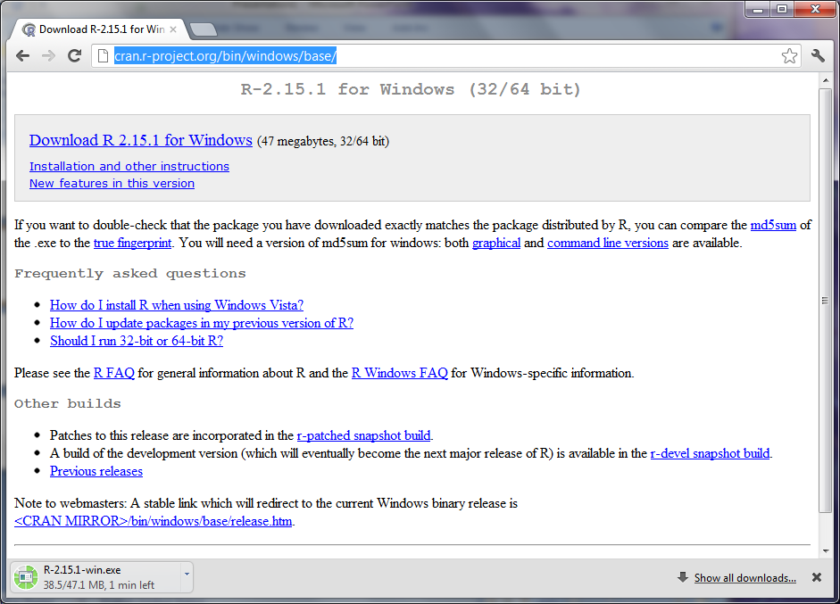
1. Download & install R : (http://cran.r-project.org/bin/windows/base/)

Slide 4
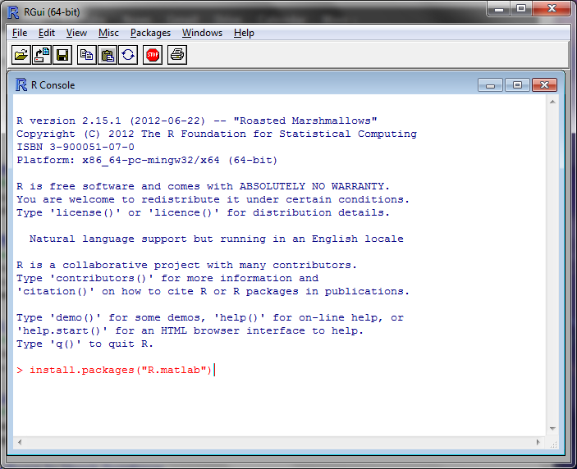
2. Install “R.matlab” package : type in command line – > install.packages(“R.matlab”)

Slide 5
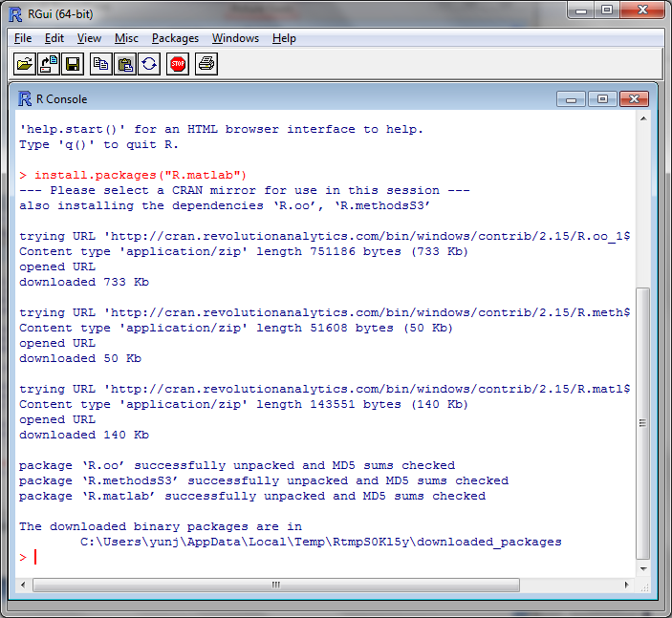
If succeed, you may see below screen.

Slide 6
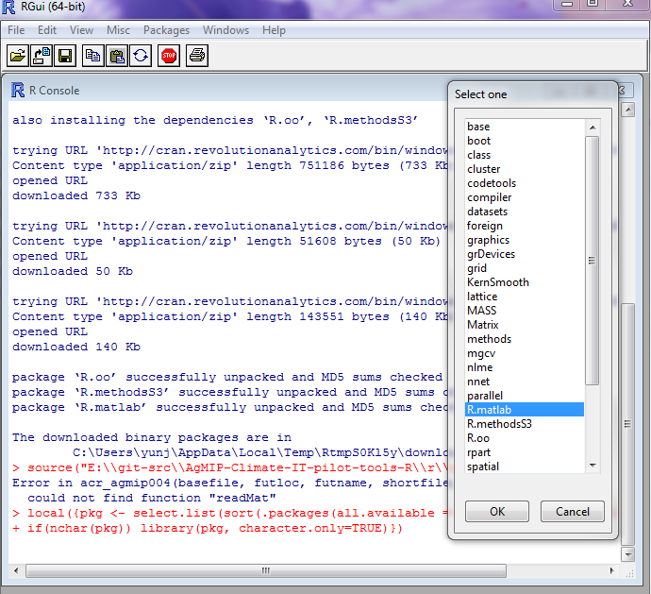
3. Load R.matlab package before run
-> R: Pakages->Load Package-> select R.matlab

Slide 7
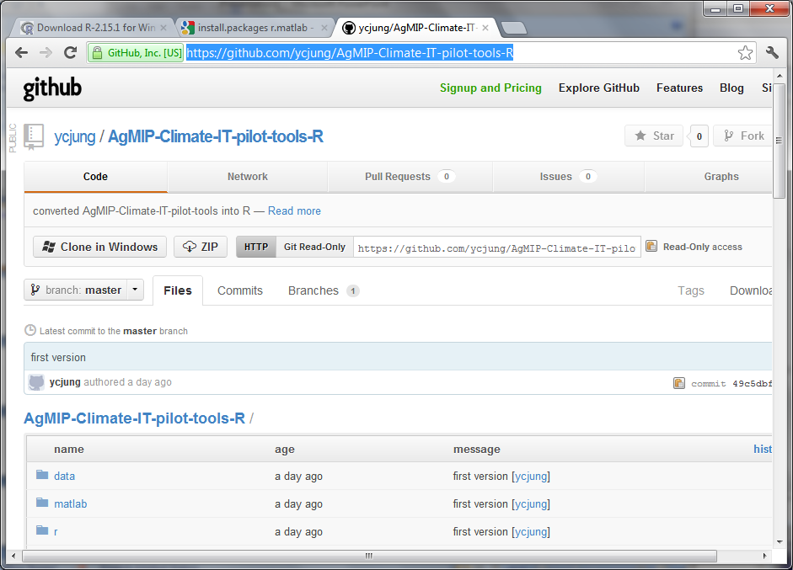
4. Download R codes from github (https://github.com/ycjung/AgMIP-Climate-IT-pilot-tools-R)
-> download all of them, and put it to your local computer.

Slide 8
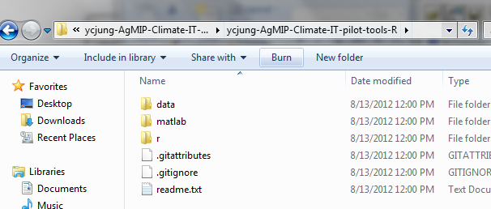
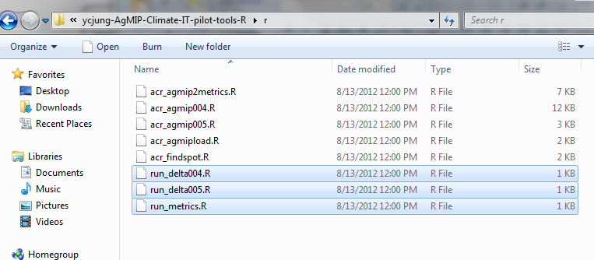
5. Check folder and files : in R folder, there are three batch R scripts to test programs

Slide 9
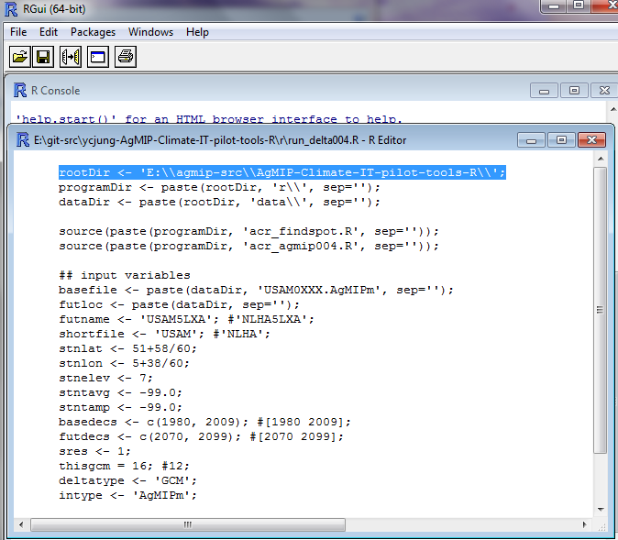
6. Modify path (rootDir) in batch file before run
->R: File->OpenScript->run_delta004.R

Slide 10
7. Run a test batch file
-> R: File->Source R Code-> run_delta004.R
- It will run ‘acr_agmip004’ automatically
To test others, follow same procedures
Input/output files can be found at data folder
Folder matlab contains original matlab script files

